Slide 1
Central Limit Theorem

Slide 2
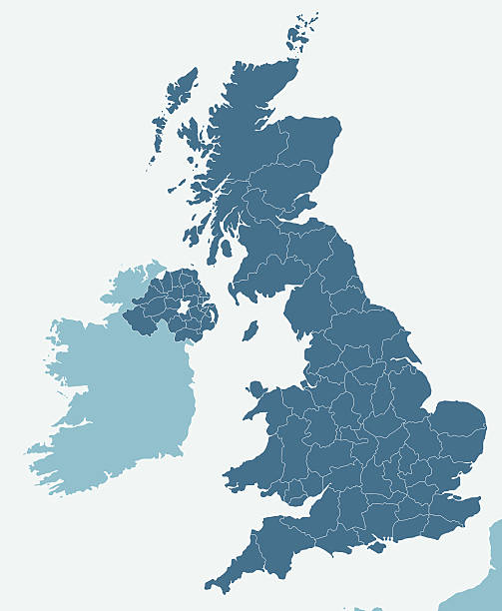
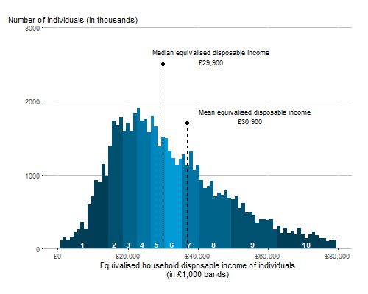

Annual Income
Lognormal distribution
Population mean: $μ$ Population SD: $σ$

Slide 3
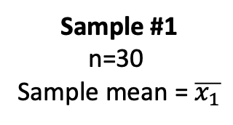
Annual Income
Lognormal distribution
Population mean: $μ$ Population SD: $σ$
Sample #1
n=30
Sample mean = $\overline{x_{1}}$

Slide 4
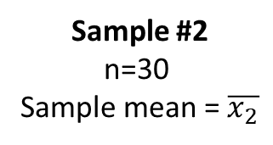
Annual Income
Lognormal distribution
Population mean: $μ$ Population SD: $σ$
Sample #1
n=30
Sample mean = $\overline{x_{1}}$
Sample #2
n=30
Sample mean = $\overline{x_{2}}$

Slide 5
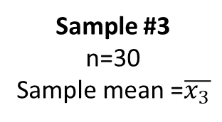
Annual Income
Lognormal distribution
Population mean: $μ$ Population SD: $σ$
Sample #1
n=30
Sample mean = $\overline{x_{1}}$
Sample #2
n=30
Sample mean = $\overline{x_{2}}$
Sample #3
n=30
Sample mean =$\overline{x_{3}}$

Slide 6
Annual Income
Lognormal distribution
Population mean: $μ$ Population SD: $σ$
Sample #1
n=30
Sample mean = $\overline{x_{1}}$
Sample #2
n=30
Sample mean = $\overline{x_{2}}$
Sample #3
n=30
Sample mean =$\overline{x_{3}}$
All possible samples
How is the sample mean distributed?

Slide 7


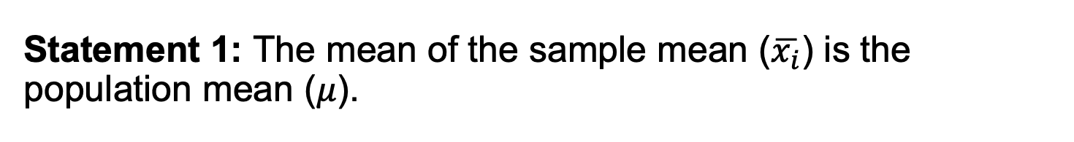



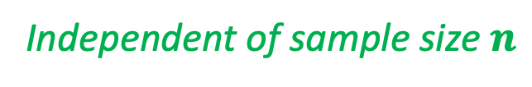

Law of large numbers
Statement 1: The mean of the sample mean ($\overline{x_{i}}$) is the population mean ($μ$).
$$μ_{\overline{x}}=μ$$
Independent of sample size $n$
$$f(x)$$
$$x$$
Population mean: $μ$ Population SD: $σ$
Sample #1
n=30
Sample mean = $\overline{x_{1}}$
Sample #2
n=30
Sample mean = $\overline{x_{2}}$
Sample #3
n=30
Sample mean =$\overline{x_{3}}$
All possible samples

Slide 8
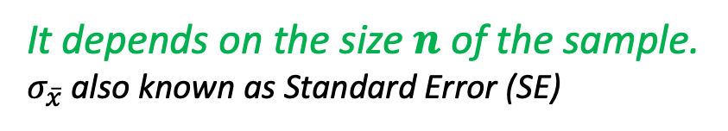

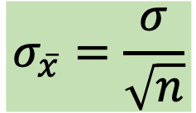
Law of large numbers
Statement 2: The SD of the sample mean ($\overline{x_{i}}$) is:
$$σ_{\overline{x}}=\frac{σ}{\sqrt{n}}$$
It depends on the size $n$of the sample.
$σ_{\overline{x}}$also known as Standard Error (SE)
$$f(x)$$
$$x$$
Population mean: $μ$ Population SD: $σ$
Sample #1
n=30
Sample mean = $\overline{x_{1}}$
Sample #2
n=30
Sample mean = $\overline{x_{2}}$
Sample #3
n=30
Sample mean =$\overline{x_{3}}$
All possible samples

Slide 9
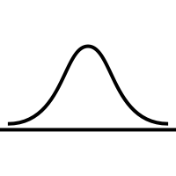


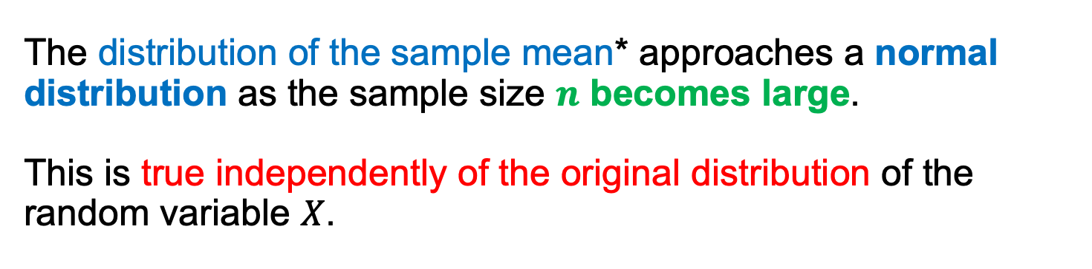



Central Limit Theorem
The distribution of the sample mean* approaches a normal distribution as the sample size $n$ becomes large.
This is true independently of the original distribution of the random variable $X$.
$$f(x)$$
$$f(\overline{x})$$
mean: $μ$
SD: $σ_{\overline{x}}=\frac{σ}{\sqrt{n}}$
$$x$$
$$μ$$
Population mean: $μ$ Population SD: $σ$
$$\overline{x}$$
*Sampling Distribution of the Sample Mean

Slide 10
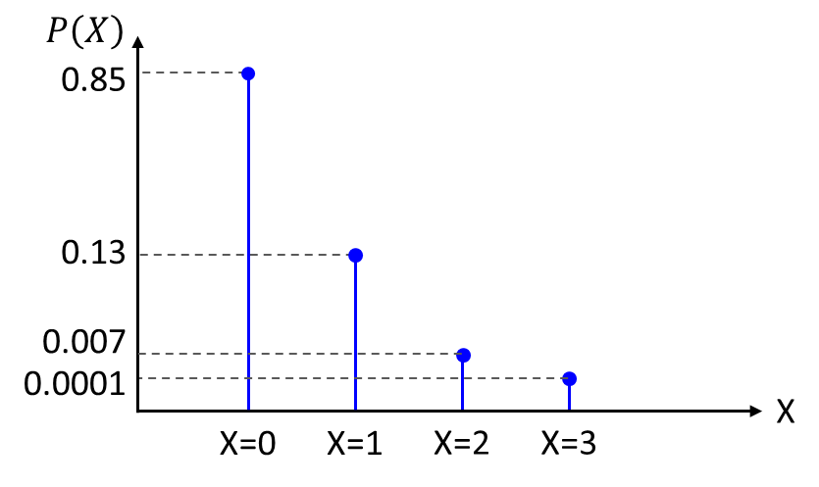
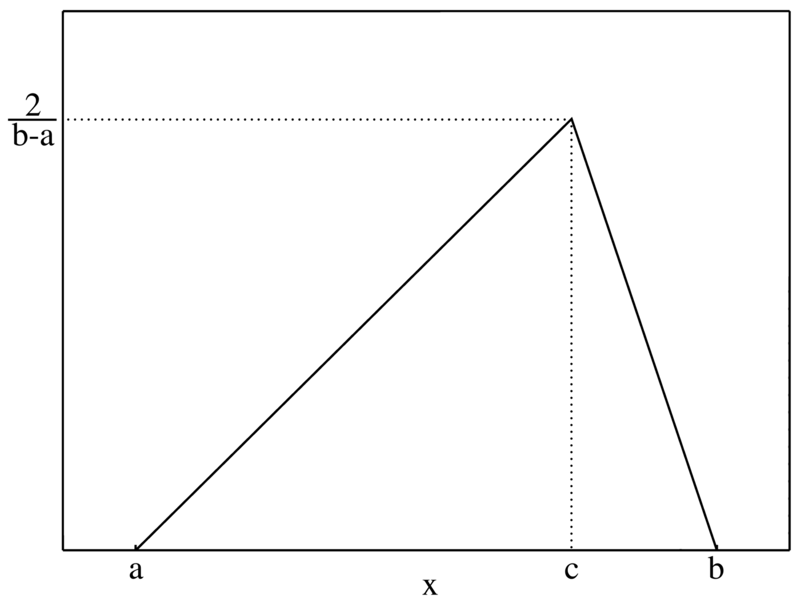
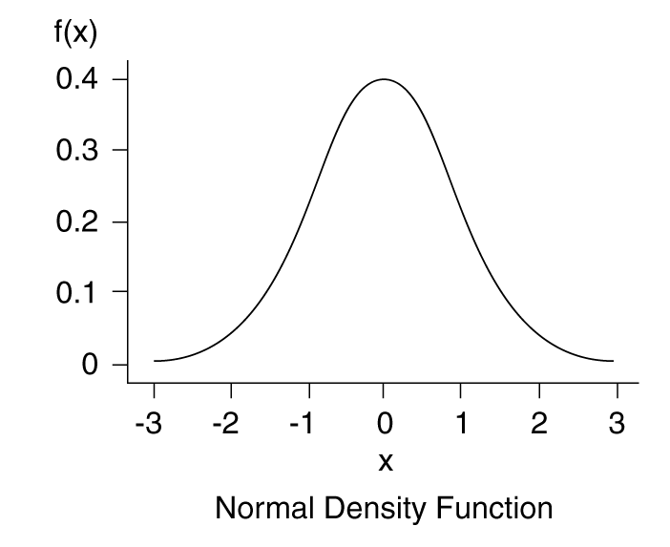
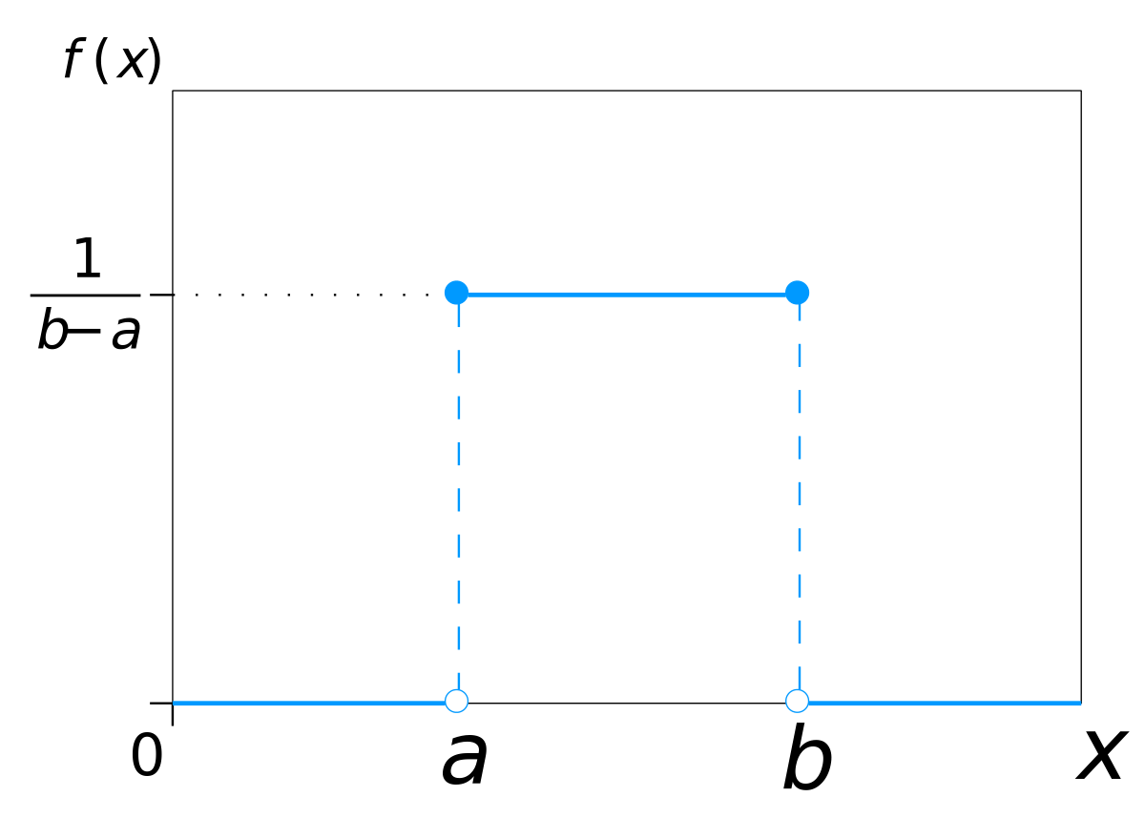
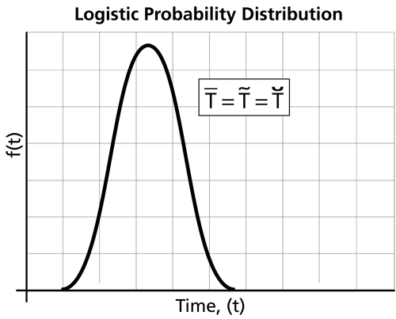
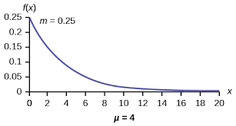
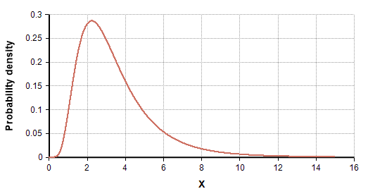




Central Limit Theorem
Population distribution
Sampling distribution
$$f(\overline{x})$$
mean: $μ$
SD: $σ_{\overline{x}}=\frac{σ}{\sqrt{n}}$
$$μ$$
$$\overline{x}$$

Slide 11



What is the average annual Income?
$$μ$$
$$\overline{x}$$

Slide 12


What does it mean large $n$?
As a rule of thumb, when $n\sim 30$ the distribution of the mean is well approximated by a normal distribution.
However, in general this number depends on the original distribution of the random variable $X$. For example, variables with a highly skewed distribution need larger $n$.

Slide 13
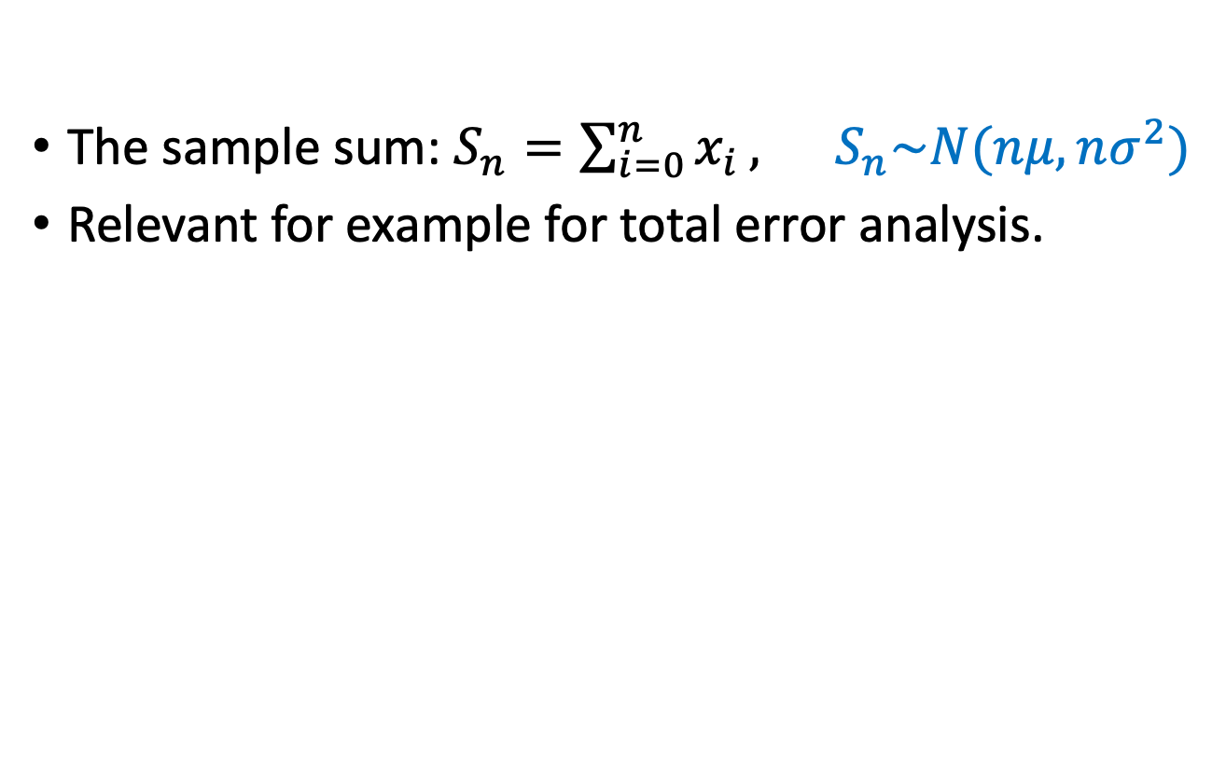


The sample sum also follows CLT
The sample sum: $S_{n}=\sum_{i=0}^{n}{x_{i}}, S_{n}\sim N(nμ, nσ^{2})$
Relevant for example for total error analysis.
$$f(x)$$
$$f(\overline{x})$$
mean: $nμ$
SD: $σ_{S_{n}}=\sqrt{n}σ$
$$x$$
$$nμ$$
Population mean: $μ$ Population SD: $σ$
$$\overline{x}$$
Sampling Distribution of the Sample Sum

Slide 14
Why is CLT important?
It allows us to make inferences about a population using sample statistics, such as confidence intervals for the mean.
It justifies the use of the normal distribution for hypothesis tests and confidence intervals.
It explains why the normal distribution is ubiquitous in statistics: when we add or average many observations, the results follows a normal distribution.

Slide 15
Many natural phenomena are additive
Many real-world variables are the result of many small independent factors adding together, leading to normality. For example:
Human traits (height, weight, blood pressure).
Measurement errors (random fluctuations in instruments).
Biological processes (metabolic rates, reaction times).

Slide 16
Example: height of a population
Height of a person determined by the combination of many small independent factors.
Genetic factors: many different genes, each contributing independently a small amount .
Nutrition, health condition, physical activity, stress, hormonal variation also contribute approximately independently.

Slide 17
